Slide 1
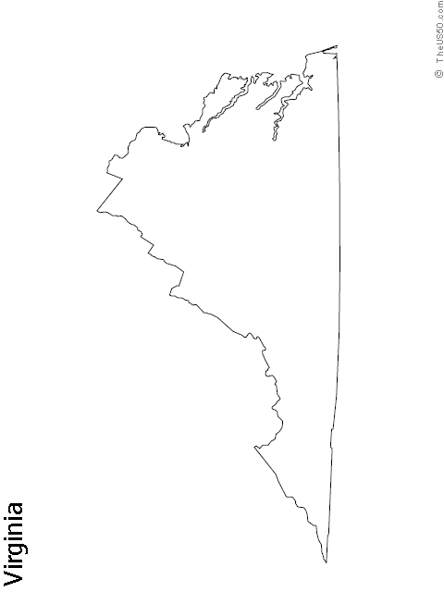
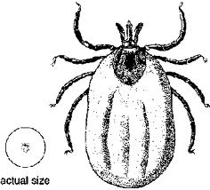
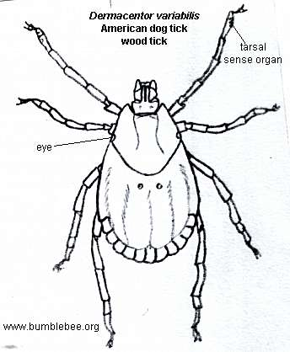
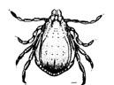
The Location of the Most Common Ticks in Virginia
Deer Tick
Lonestar Tick
American Dog Tick
Brown Dog Tick
1.
3.
4.
2.
*The Deer Tick is primarily found in the North. The American Dog Tick is found West of the Blue Ridge Mountains. The Lonestar Tick is primarily found East of the Blue Ridge Mountains. The Brown Dog Tick is found all throughout Virginia.

