Slide 1
Tick Removal

Slide 2
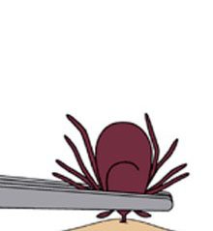
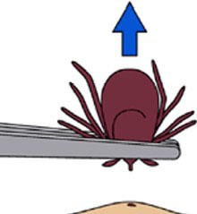
From the CDC
Using fine tip tweezers to grab the tick as close to the skin as possible.
Pull it up with steady pressure, making sure to get all parts of the tick. If the whole thing doesn’t come out, its mouth parts can remain in the person, which will also need to be removed with tweezers.
After it is removed, thoroughly clean the area and hands with rubbing alcohol, iodine scrub, or soap.
Centers for Disease Control and Prevention. Centers for Disease Control and Prevention, 03 Feb. 2014. Web. 25 Mar. 2014.

Slide 3
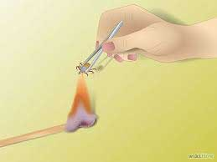
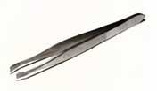
Home Remedies
Tweezers: Pulling the tick out of the skin. This is the best home method to remove a tick.
Using heat: Use a hot match to burn it off. This is ineffective and dangerous because it can cause damage to your skin.
Alcohol: Pour on the tick to kill it. Very ineffective myth.
Freezing: Rub ice cube on the tick. Ineffective.
Petroleum jelly: Painting the tick with things such as Vaseline. Ineffective, can cause the tick to regurgitate fluids into the wound and is not recommended by the CDC.
Not recommended
#1
"Home Remedies for Tick Removal." - My Home Remedies. Web. 26 Mar. 2014. <http://www.myhomeremedies.com/topic.cgi?topicid=337>.

Slide 4
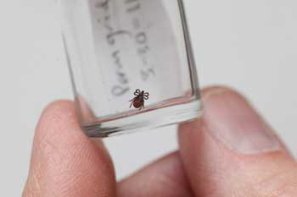
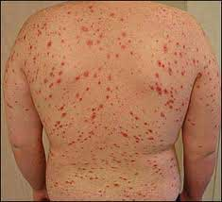
Post-Tick Removal
Washing the area with soap and warm water is the most effective way to clean the area.
After removal, keep tick in a jar for a few weeks just in case it might carry diseases such as Lyme Disease, Rocky Mountain Spotted Fever, or Ehrilichiosis.
Watch the area for rashes.
http://www.fordham.edu/campus_resources/enewsroom/inside_fordham/august_8_2011/news/is_the_calder_center_79698.asp

Slide 5
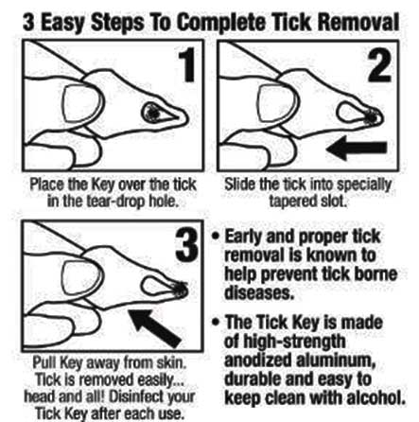
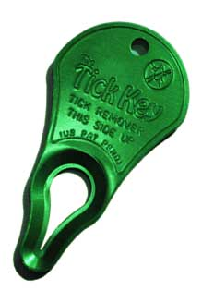
According to the manufacturer,
TickKey is 99.9% effective in the safe removal of all sizes and types of ticks on both people and pets
TickKey
http://www.tickkey.com/index.html
Permission granted.

Slide 6
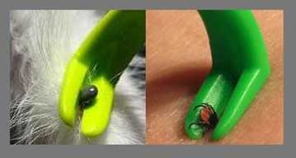
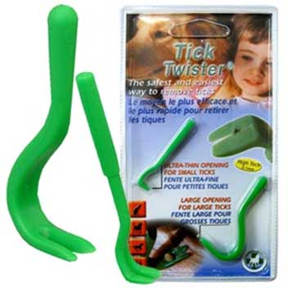
Tick Twister
The Tick Twister is effective on both humans and animals
According to the Borreliosis and Associated Diseases Awareness (BADA) the Tick Twister cradles the body of the tick and doesn’t exert pressure to either its mouth or its abdomen.
It can be safely twisted in one direction.
This allows the tick’s grasp to be freed from the surrounding tissue.
http://www.bada-uk.org/correct-tick-removal/tick-removal-tick-removal-tool

